Slide 1
CAP615:PROGRAMMING IN JAVA
Unit-1
INTRODUCTION

Slide 2
Computer Program
Writing program to perform task by computer.
Program is set of instructions
Program can be written by any programming language(low level/ high level) like: assembly language, c, c++, java etc.
Computer only can understand machine language but it is very difficult to understand by programmer so overcome this we are using high level language.

Slide 3
Features of Java Language
Easy to develop applications
Platform Independent
Architectural Neutral
Portable
Multithreaded
Distributed
Robust
Object Oriented

Slide 4
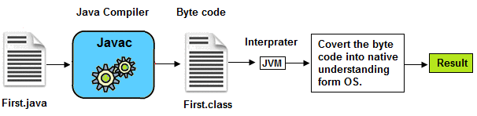
1. Easy to develop applications
As compare to C and C++ , no pointer concept
Atomatic memory allocation and deallocation
Which makes easy to develop applications.

Slide 5
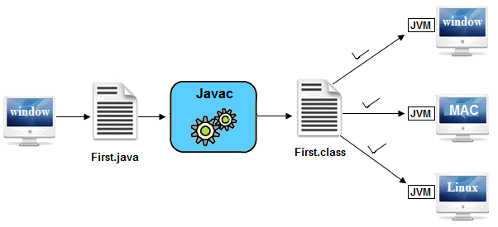
2. Platform Independent

Slide 6
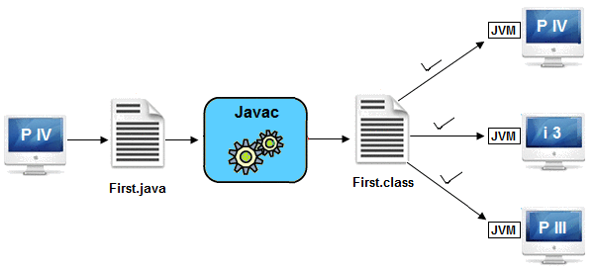
3. Architectural Neutral
Architecture represents processor.
It can run on any processor

Slide 7

4. Portable
Platform independent and architectural neutral features makes its portable.

Slide 8
5. Multithreaded
you can perform multiple operations at the same time.
Threads are independent, so it doesn't affect other threads.

Slide 9


Multithreading Example

Slide 10
Examples:
Typing MS Word document while listening to music.
You can use multiple objects in games like cars, motor bikes, animals, people etc.
Railway ticket reservation system where multiple customers accessing the server.
Multiple account holders accessing their accounts simultaneously on the server. When you insert a ATM card, it starts a thread for perform your operations.

Slide 11
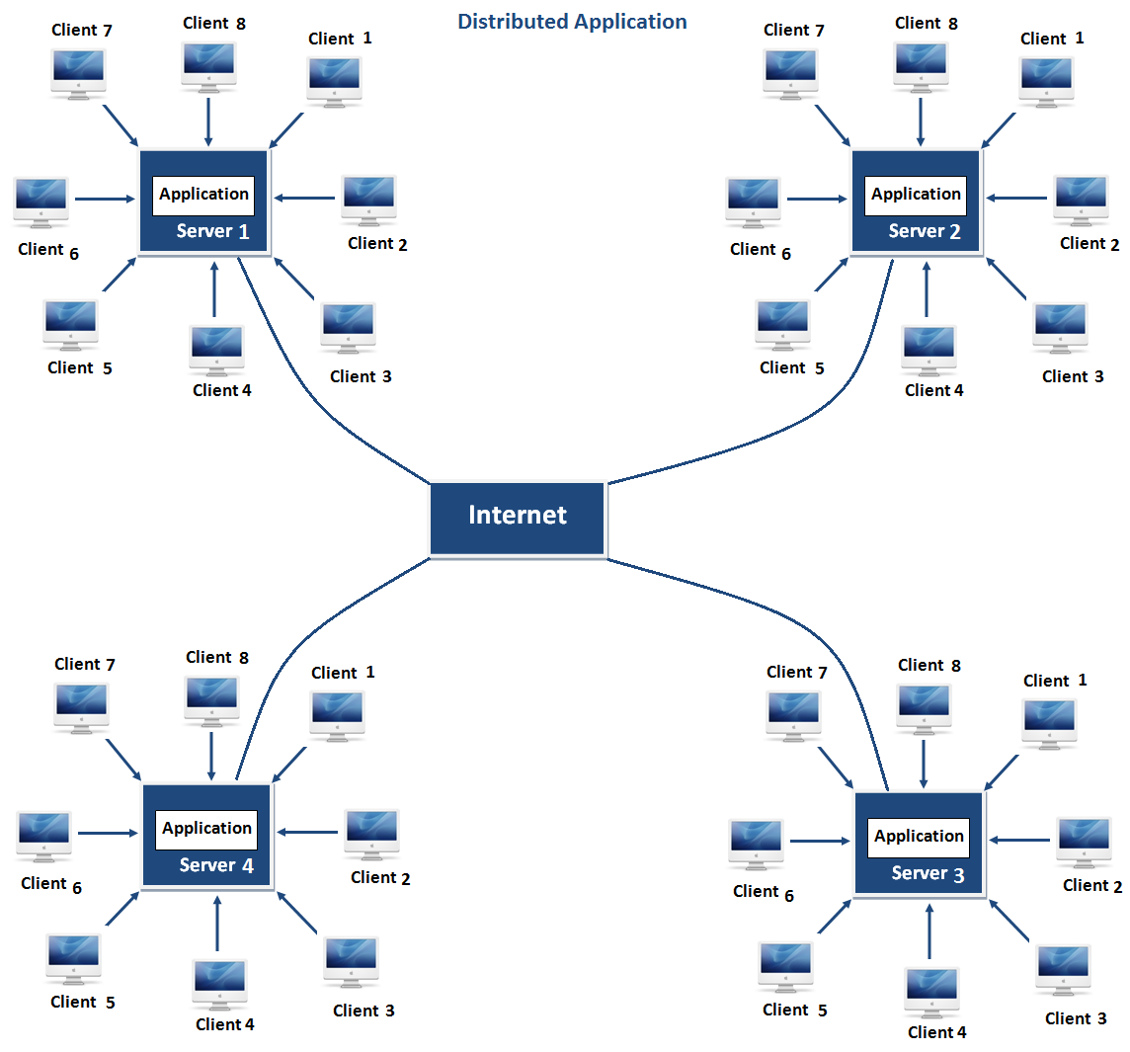
6. Distributed
Same application can run in different different server.
Advantage:problem occurred in one server will never be reflected on any client system.

Slide 12
7. Robust
It is robust or strong Programming Language because of its capability to handle Run-time Error, automatic garbage collection, the lack of pointer concept, Exception Handling. These features make it a robust Language.

Slide 13
8. Object Oriented
Java is OOPs based
Data Encapsulation
Data Abstraction
Polymorphism
Inheritance

Slide 14
Java technology and development environment
Java technoloy provides us to develop different type of applications it can be console based, window/desktop based or web based etc.
There are different types of Java editions are avialable to develop these applications:
  Java Standard Edition (JSE)
  Java Enterprise Edition(JEE)
  Java Micro Edition(JME)

Slide 15
Java Standard Edition (JSE)
  JSE can be used to develop client-side standalone (independant) applications or applets.
Java Enterprise Edition (JEE)
  JEE can be used to develop server-side applications such as Java servlets and Java ServerPages.
Java Micro Edition (JME).
  JME can be used to develop applications for mobile devices such as cell phones.

Slide 16
development environment
By using JDK(java development kit)
By using IDE(integrated development Environment) like: net beans, Eclipse, etc.

Slide 17
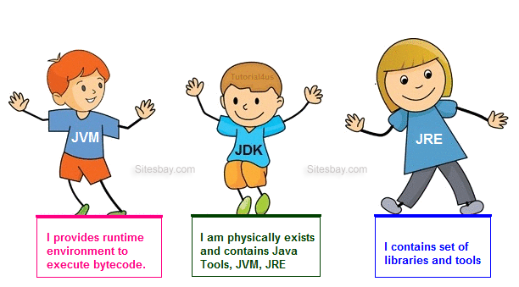
Working of JVM, JDK and JRE

Slide 18
running/ testing a java program
Steps:->
- Save the file with extension .java in D Drive.
Note: The file name should be same as class name
- Compile the program on command prompt, open the command prompt and move to D drive.
- Now compile the programme with javac command
d:\> javac Test.java
[here test.java is our filename]
After compilation now run the programme by using java filename
d:\> java Test
Note: here during running of the program extension name is not required.
class test
{
public static void main (String []args)
{
System.out.println("hello");
}
}

Slide 19
java classes, objects, the main method
Class and Object:
- Class is a collection of member data and member methods.
- Object is an instance of class.

Slide 20
Syntax to declare a class:
class <class_name>
{
data_member;
member_method;
}
Defining scope of
The class

Slide 21
Basic structure of Java Program:
[ Documentation ]
[package declarations]
[import statements]
[class declaration]
[Main Merthod]

Slide 22
// A Simple java program
package test;
import java.lang;
class Demo
{
public static void main(String[] args)
{
Sytem.out.println("Hello! World");
}
}

Slide 23
Main method in Java:
public static void main(String args[])
The keyword public is an access specifier.
The keyword static is a kind of modifier. Main method is static means this is calling with out any reference.
The keyword void means that the method main() does not return any value.
Main method having parameter that array of string which show command line arguments in java. We can pass any no. of argument during run time.

Slide 24
Java Command Line Arguments
The java command-line argument is an argument i.e. passed at the time of running the java program.
Ex:
class CommandLineEx{
public static void main(String args[]){
System.out.println("Your first argument is: "+args[0]);
} }
Now compile : c:\> javac CommandLineEx.java
Now run: c:\> java CommandLineEx hello world

Slide 25
defining fields and methods
Class class_Name
{
Access_Specifier fileld_type fieldName;
Access_Specifier return_type methodName()
{
// body of method
}
}

Slide 26
declaring, instantiating and initializing objects
Declaring :
class ClassA
{
}
ClassA objname=new ClassA();
When you create an object, you are creating an "instance" of a class, therefore "instantiating" a class.

Slide 27
static keword
We can use static keyword with variables, methods, class and nested class.
If you declare any variable as static, it is known as a static variable.
Static variable also known as a class variable
The static variable gets memory only once
It can be used as for unique purpose for example company name of employees, college name of students

Slide 28
variables
A name of reserved area allocated in memory
variable
n
10
num

Slide 29
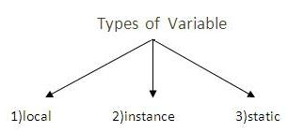
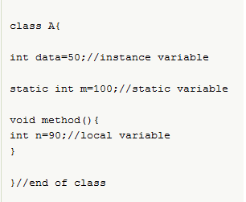

Slide 30
Instance vs static
Instance variables gets the memory at the time of object creation, each object will have the copy of instance variable, if it is incremented, it won’t reflect to other objects.
Static variable will get the memory only once, if any object changes the value of the static variable , it will retain its value.

Slide 31
Working with strings
Sequence of characters , writes between “ ”.
<String_Type> <string_variable> = <sequence_of_charcters>”;
String name = “Lovely”;
Creating a String
There are two ways to create string in Java:
String literal
  String s = “Lovely”;
Using new keyword
  String s = new String (“Lovely”);

Slide 32
manipulating numeric data
working with numbers
- six numeric types four integer and two floating point:
byte 1 byte -128 to 127
short 2 bytes -32,768 to 32,767
int 4 bytes -2,147,483,648 to 2,147,483,647
long 8 bytes -9,223,372,036,854,775,808 to 9,223,372,036,854,775,80
float 4 bytes 7 decimal digits
double 8 bytes 16 decimal digits

Slide 33
Data types in java
Data types means which define which type of data we are using in the program.
To declare the variable
Can be Categorize in primitivies and non primitives
Primitives means user define and non primitive means user has to define

Slide 34
Data types in Java
Primitive
Non primitive
Boolean
Byte
Short
Int
Long
Char
Float
Double
String
Array
Class
Interface

Slide 35
Data types and its size
Data Type | Default Value | Default size
boolean | false | 1 bit
char | '\u0000' | 2 byte
byte | 0 | 1 byte
short | 0 | 2 byte
int | 0 | 4 byte
long | 0L | 8 byte
float | 0.0f | 4 byte
double | 0.0d | 8 byte

Slide 36
Operators
Operators are special symbols used for:
  mathematical functions
  assignment statements
  logical comparisons
Examples of operators:
  3 + 5 // uses + operator
  14 + 5 – 4 * (5 – 3) // uses +, -, * operators
Expressions:
C=a+b
can be combinations of variables and operators that result in a value

Slide 37
Operators in java
Arithmetic Operators
Relational Operators
Increment/Decrement Operators
Logical Operators
Assignment Operators
Bitwise Operators

Slide 38
Arithmetic Operators
Operator | Operation
+ | addition
- | subtraction
* | multiplication
/ | division
% | modulus (remainder after division)

Slide 39
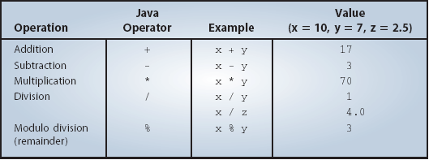
Arithmetic Operators
The following table summarizes the arithmetic operators available in Java.
This is an integer division where the fractional part is truncated.

Slide 40
Arithmetic/Assignment Operators
Java allows combining arithmetic and assignment operators into a single operator:
  Addition/assignment +=
  Subtraction/assignment −=
  Multiplication/assignment ∗=
  Division/assignment /=
  Remainder/assignment %=

Slide 41
Increment/Decrement Operators
Only use ++ or − − when a variable is being incremented/decremented as a statement by itself.
x++; is equivalent to x = x+1;
x--; is equivalent to x = x-1;

Slide 42
Relational Operators
Relational operators compare two values
They Produce a boolean value (true or false) depending on the relationship
Operation | Is true when
a >b | a is greater than b
a >=b | a is greater than or equal to b
a ==b | a is equal to b
a !=b | a is not equal to b
a <=b | a is less than or equal to b
a <b | a is less than b

Slide 43
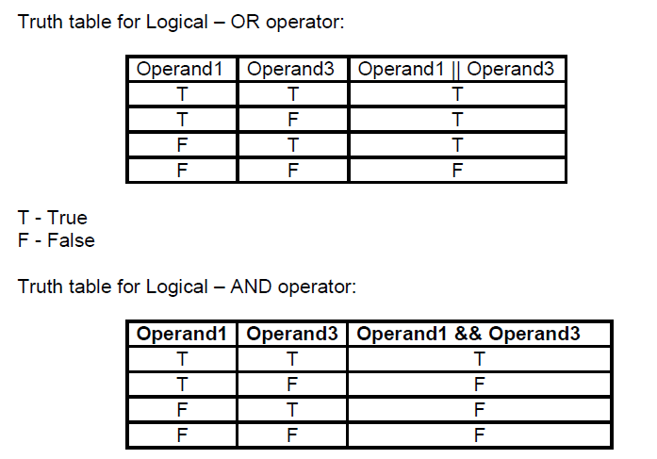
Logical Operators
Symbol Name
  && AND
  || OR
  ! NOT

Slide 44
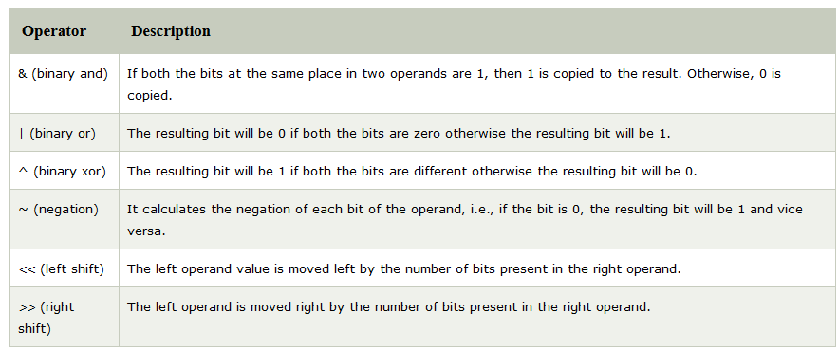

Slide 45
Bitwise OR (|) :
if either of the bits is 1, it gives 1, else it gives 0.
a = 5 = 0101 (In Binary)
b = 7 = 0111 (In Binary)
Bitwise OR Operation of 5 and 7
0101
|0111
________
0111 = 7 (In decimal)

Slide 46
Bitwise AND (&) –
if both bits are 1, it gives 1, else it gives 0.
a = 5 = 0101 (In Binary)
b = 7 = 0111 (In Binary)
Bitwise AND Operation of 5 and 7
0101
& 0111
________
0101 = 5 (In decimal)

Slide 47
Bitwise XOR (^) –
if corresponding bits are different, it gives 1, else it gives 0.
a = 5 = 0101 (In Binary)
b = 7 = 0111 (In Binary)
Bitwise XOR Operation of 5 and 7
0101
^ 0111
________
0010 = 2 (In decimal)

Slide 48
Bitwise Complement (~) –
with all bits inversed, means it makes every 0 to 1, and every 1 to 0.
a = 5 = 0101 (In Binary)
Bitwise Compliment Operation of 5
~ 0101
________
1010 = 10 (In decimal)
Note: Compiler will give 2’s complement of that number, i.e., 2’s compliment of 10 will be -6.

Slide 49
Shift operator
Right shift operator (>>) –
Shifts the bits of the number to the right and fills 0 on voids left as a result.
Example 1:
a = 10
a>>1 = 5
Example 2:
a = -10
a>>1 = -5
We preserve the sign bit.

Slide 50
Left shift operator (<<) –
Shifts the bits of the number to the left and fills 0 on voids left as a result.
a = 5 = 0000 0101
b = -10 = 1111 0110
a << 1 = 0000 1010 = 10
a << 2 = 0001 0100 = 20
b << 1 = 0000 1010 = -20
b << 2 = 0001 0100 = -40

Slide 51
if/else constructs
If(condition)
{
// statement execute when condition true
}
else
{
// statement execute when condition false
}

Slide 52
switch statement
To select choices/options from user it used:
Switch with choice (integer value like: 1,2,..)
Switch with choice (character value like: A,B,..)
Switch with choice (String value like: “ADD”,”SUB”,..)

Slide 53
looping controls, nested loops
While loop
Do while loop
For loop
Enhanced or advanced for loop
Nested loops means one loop inside another loop.

